Slide 1



Automated docking in robot
ENPM 673 (Group -5)

Slide 2
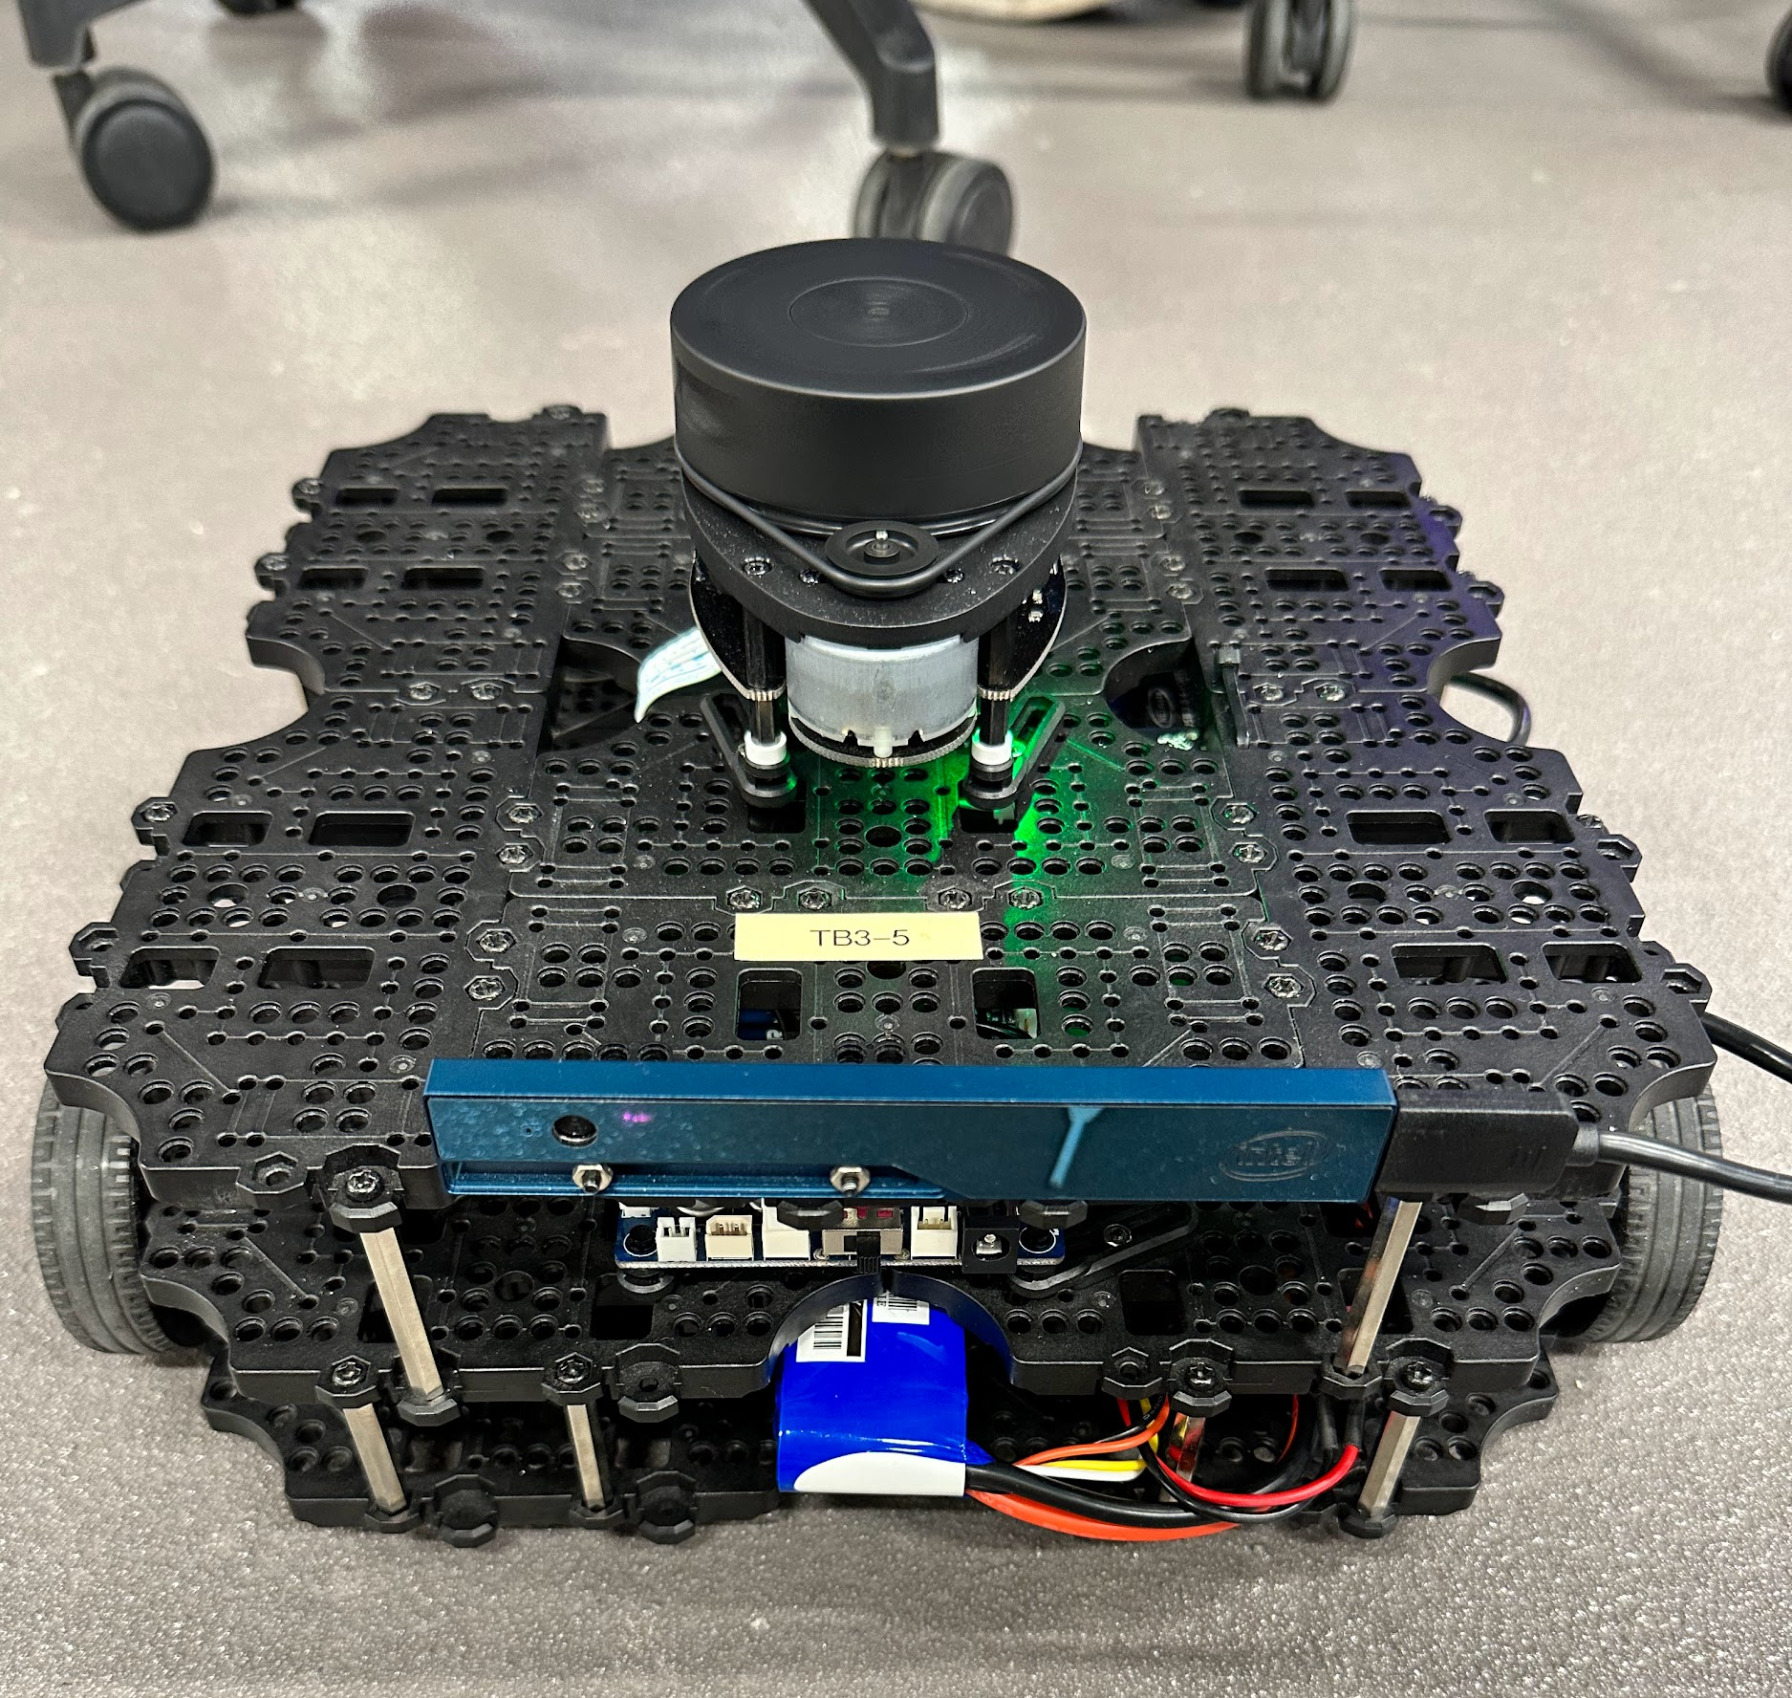
Introduction
Autonomously locate the charging station
Plan collision free path
Align itself with the docking station
Notes:
THe problem is about automatically locating the charging station and then avoid the obstacle to reach the station. We approached this by using aruco markers, lidar sensor, Camera..

Slide 3
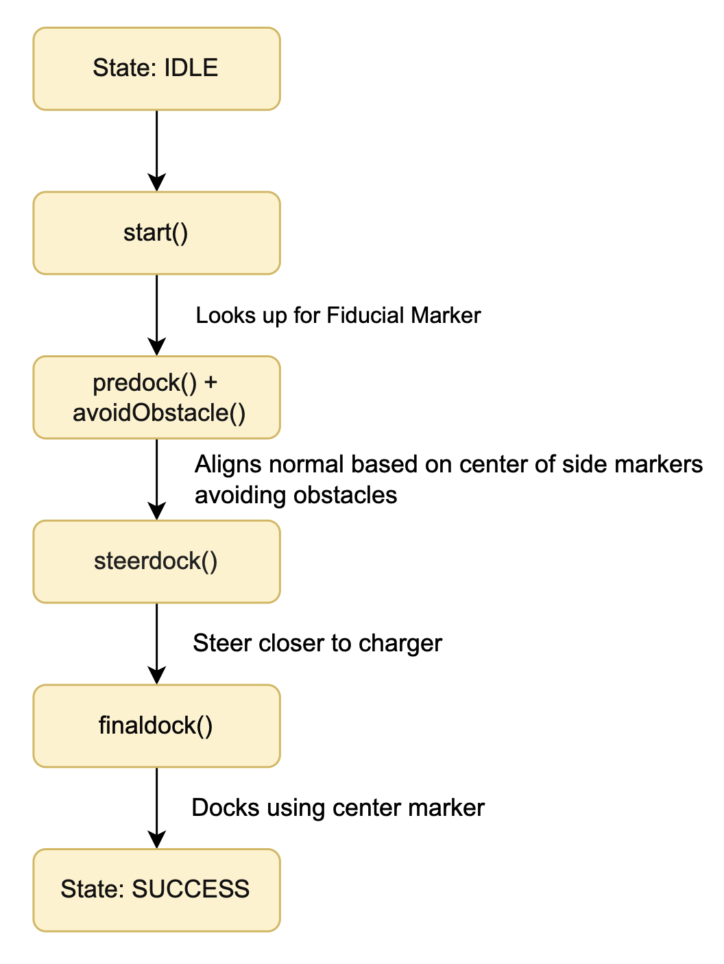
Pipeline
Notes:
This is how our pipeline looks. We start from first detecting the obstacles, and then do something which we call as pre_dock, basically aligning the tutlebot, then we steer the turtlebot towards the charging station and finally parking it there.
To discuss in detail here are the individual steps.

Slide 4

Pipeline
Pre-docking:
Identify both markers center? No?
Single marker? No?
Exit
Single marker? Yes?
Get pose estimation and adjust yaw for rotation
Once the center of both the markers are detected we take 2d_poses from both the side markers and calculate the avg to calculate the normal and align the robot perpendicular to the docking station.
Notes:
This is how our pipeline looks. We start from first detecting the obstacles, and then do something which we call as pre_dock, basically aligning the turtlebot, then we steer the turtlebot towards the charging station and finally parking it there.
To discuss in detail here are the individual steps.
The center of both the markers are detected using tf, tf1 and tf2 gived the x,y coordinates and then avg each x,y to get center of the individual side markers

Slide 5
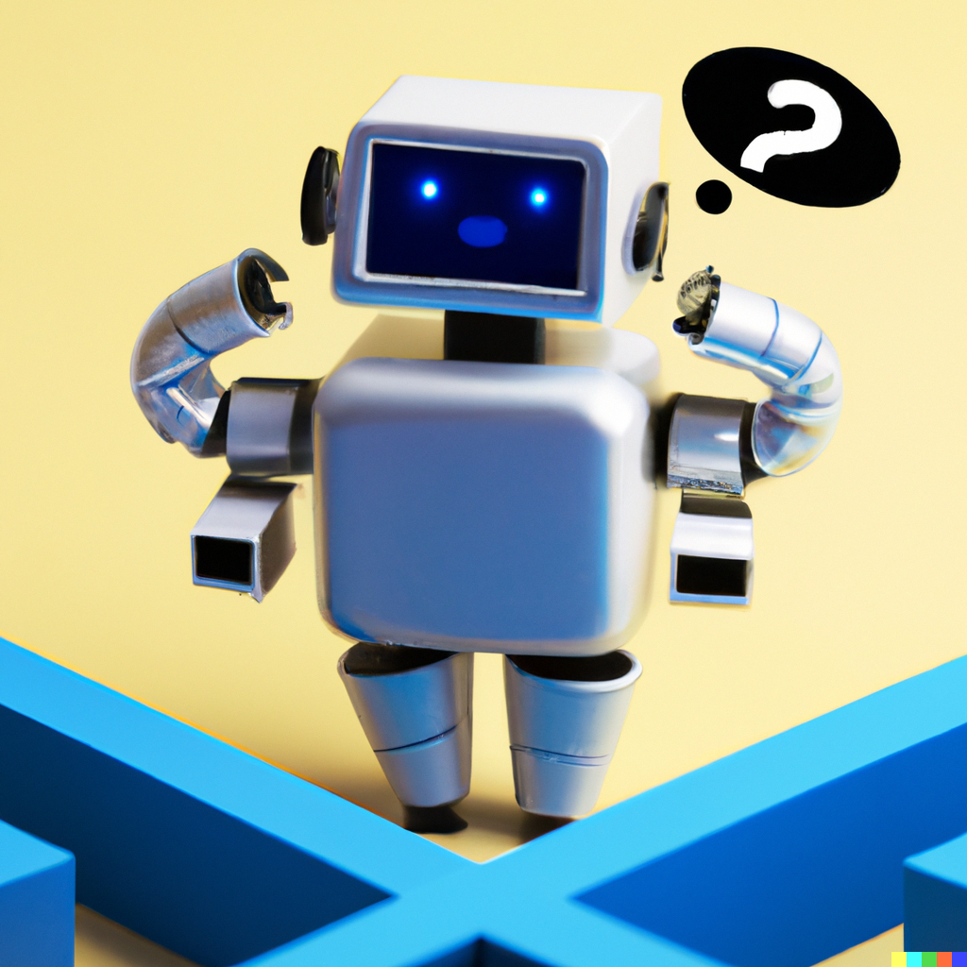
Pipeline
Obstacle Avoidance:
Lidar
Stop robot motion and assess clearance.
Resume motion once clear path is identified.
Camera + Lidar
Color segmentation
Finding contours
Decision to avoid

Slide 6
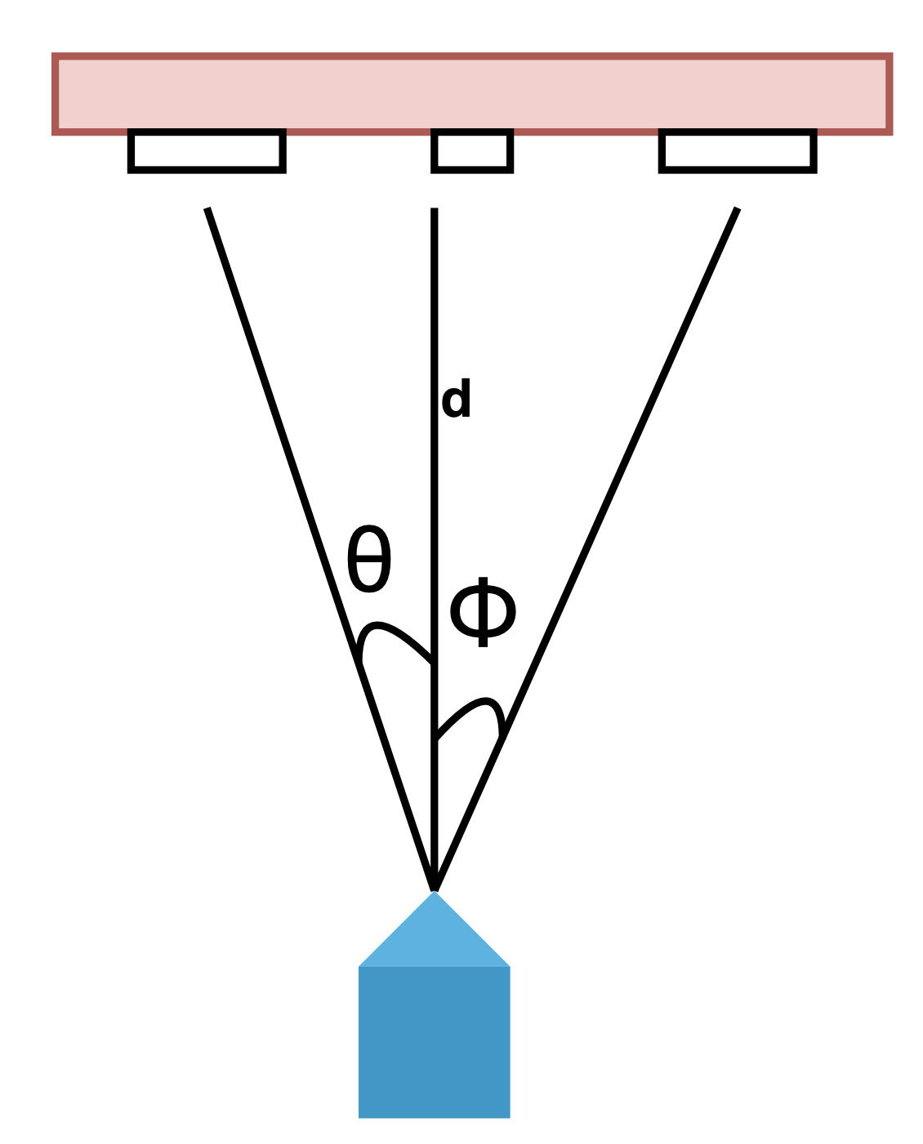
Pipeline
Steer-docking:
Get closer to the docking station
Once the center of side markers are detected, get their position
Calculate the angular velocity using saturation proportional filter
Notes:
Check the distance if these side markers with a threshold distance that have been set, if the distance is too much there is no tolerance and code stops, if the distance is okay already go to last_mile
It calculates an angular velocity (ang_vel) using a saturation proportional filter based on the offset value.
In filter: ensures that the output stays within specified upper and lower bounds. If the input exceeds these boundaries, the output is clamped to the corresponding boundary value.

Slide 7
Pipeline
Final-docking:
Uses the center marker only to cover the last stretch of docking
Calculate the distance, yaw angle, and update the remaining distance based on the calculated values and configuration parameters.
Remaining distance is the distance the bot has to cover to reach the station.
Notes:
This is how our pipeline looks. We start from first detecting the obstacles, and then do something which we call as pre_dock, basically aligning the tutlebot, then we steer the turtlebot towards the charging station and finally parking it there.
TO discuss in detail here are the individual steps.
transformation matrix (centre_tf_mat) for the center marker. When the TurtleBot is far away from the markers, the code doesn't pay much attention to how the markers are rotated. Instead, it focuses on where the markers are located. By looking at their positions, the code figures out how much the TurtleBot needs to move and in which direction to reach the right spot. This way, it doesn't get confused by the markers' wrong rotations.
As the TurtleBot gets closer to the markers, the code starts using the markers' rotations to help it align properly. It looks at the way the markers are turned and adjusts the TurtleBot's angle accordingly, so it can dock itself correctly and parallel to the markers' surface.
To sum it up, when far away, the code cares about the markers' positions for moving the TurtleBot. But when close, it pays attention to the markers' rotations to dock the TurtleBot the right way.

Slide 8

Results

Slide 9
Results

Slide 10
Results

Slide 11
Results

Slide 12
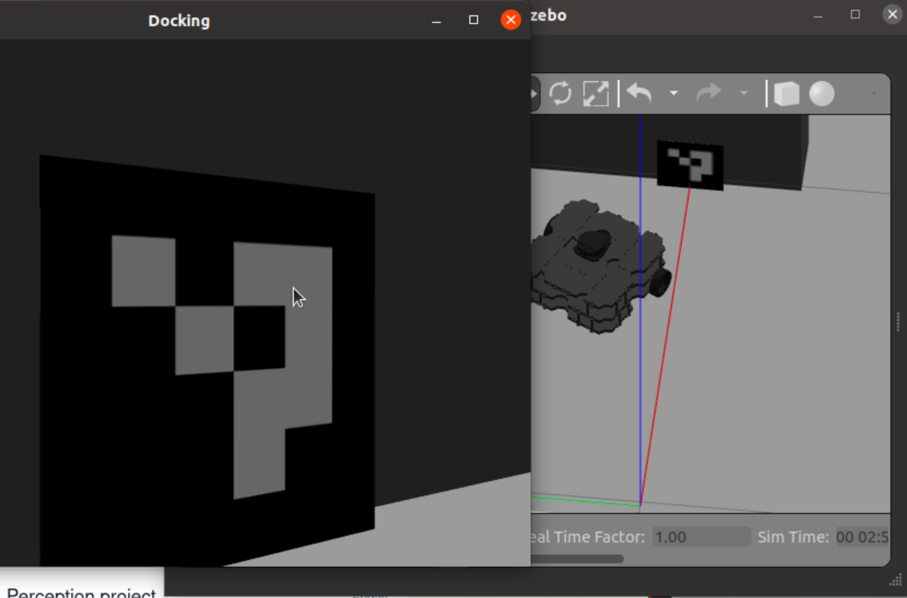
Difficulties
Integrating obstacle avoidance with docking
No stable connection b/w Intel Realsense camera and Microcontroller
Relative position between markers effected tf transformations in real world.
Difficult to steer the robot with just one marker
Hardware limitation

Slide 13
Future Work
Making the dynamic obstacle avoidance more robust using deep learning
Integrating the existing package with slam so the robot can explore to find the docking station.
Combining ArUco marker detection with depth camera can provide additional information for more accurate and reliable docking.

Slide 14
Contributions
Neha Marne, Anukriti Singh - Docking, Research, Hardware
Sai Teja and Surya Chappidi - Docking, Obstacle avoidance, Hardware
Abhinav Sagar - Research, Hardware

Slide 15
Thank You
ENPM 673 Group -5

